Slide 1
CCSS Module 3 Effective Instruction
The role of the teacher
12/19/12
Notes:
Part One

Slide 2
Objectives
Teachers will explain the essential characteristics of the Standards for Mathematical Practice.
Teachers will explain the essential characteristics of Number Talks.

Slide 3
Review of Six Shifts from 97 Standards to CCSS
Focus
Coherence
Fluency
Deeper Understanding
Application
Dual Intensity
PREPARE ALL STUDENTS FOR COLLEGE AND CAREERS
Notes:
Part One: TPS the differences and similarities, on going double bubble

Slide 4
Module 3 Effective Instruction
“A long line of students has established that the single most important school influence on student learning is the quality of the teacher.” Linda Darling-Hammond
Notes:
Part One: What is the role of a teacher?

Slide 5
CA Standards for the Teaching Profession
Engaging and supporting all students
Understanding and organizing content
Planning instruction
Assessing student learning
All of these things connect to Common Core.
Notes:
Part One

Slide 6
Effective instruction
Common core does not discuss pedagogy, just the “what”. The topics of the standards are the same, but the expectations and outcomes are different. This will make the classroom different.
Lecture 5%, Reading 10%, Audio-Visual 20%, Demonstration 30%, Discussion Group 50%, Practice by Doing 75%, Teach Others/Immediate Use 90%
How does this change instruction?
Notes:
Part One: TPS How does this change instruction

Slide 7
21st Century Thinking
Critical Thinking and Problem Solving: Reasoning effectively
Communication: clearly and effectively through reading, writing, and speaking
Collaboration: working in diverse teams, demonstrating initiative, demonstrating leadership
Creativity and Innovation: working well with others
Construction of Knowledge: integration of content from one subject
Notes:
Part One

Slide 8
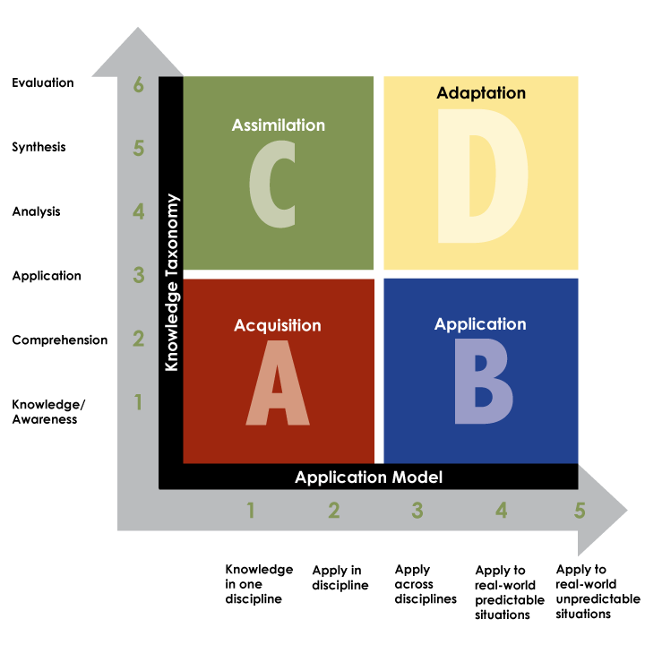
Rigor/Relevance Framework ®
International Center for Leadership in Education (n.d.)
Notes:
Part One
Dr. Willard Dagget/Throughout a unit of study students should be exposed to all 4 quadrants/ Being intentional about what we design for our students/ Every quadrant has a purpose
TIME: 10 minutes (for Slides 10 to 19)
INTENT: To lay the groundwork of “why” we need the CCSS
___________________________________________________________________________________
In addition to actively engaging students in the learning process, we need to help students think critically.
In order to prepare our students for a global economy, we need to teach them how to apply and adapt their learning to predictable and unpredictable situations that arise in the future. We are preparing them for jobs of the future that do not exist as of yet. Incorporating more rigorous and relevant instruction in classrooms is necessary for the development of 21st century thinking skills.
The Rigor/Relevance Framework was created by the International Center for Leadership in Education founded by Dr. Willard Dagget. “It is a tool to examine curriculum, instruction, and assessment.”¹
The Framework shows the relationship between the Knowledge Taxonomy (Bloom’s) and the Application Model. Both are equally important in developing rigorous and relevant instruction.
Ask participants to locate the handout, “Using the Rigor/Relevance Framework for Planning and Instruction.” As we take a closer look at each quadrant, participants will refer to the handout to see examples of specific math activities in elementary, middle, and secondary classrooms.
HANDOUTS:
Using the Rigor/Relevance Framework for Planning and Instruction
¹International Center for Leadership (n.d.). Rigor/Relevance Framework.

Slide 9
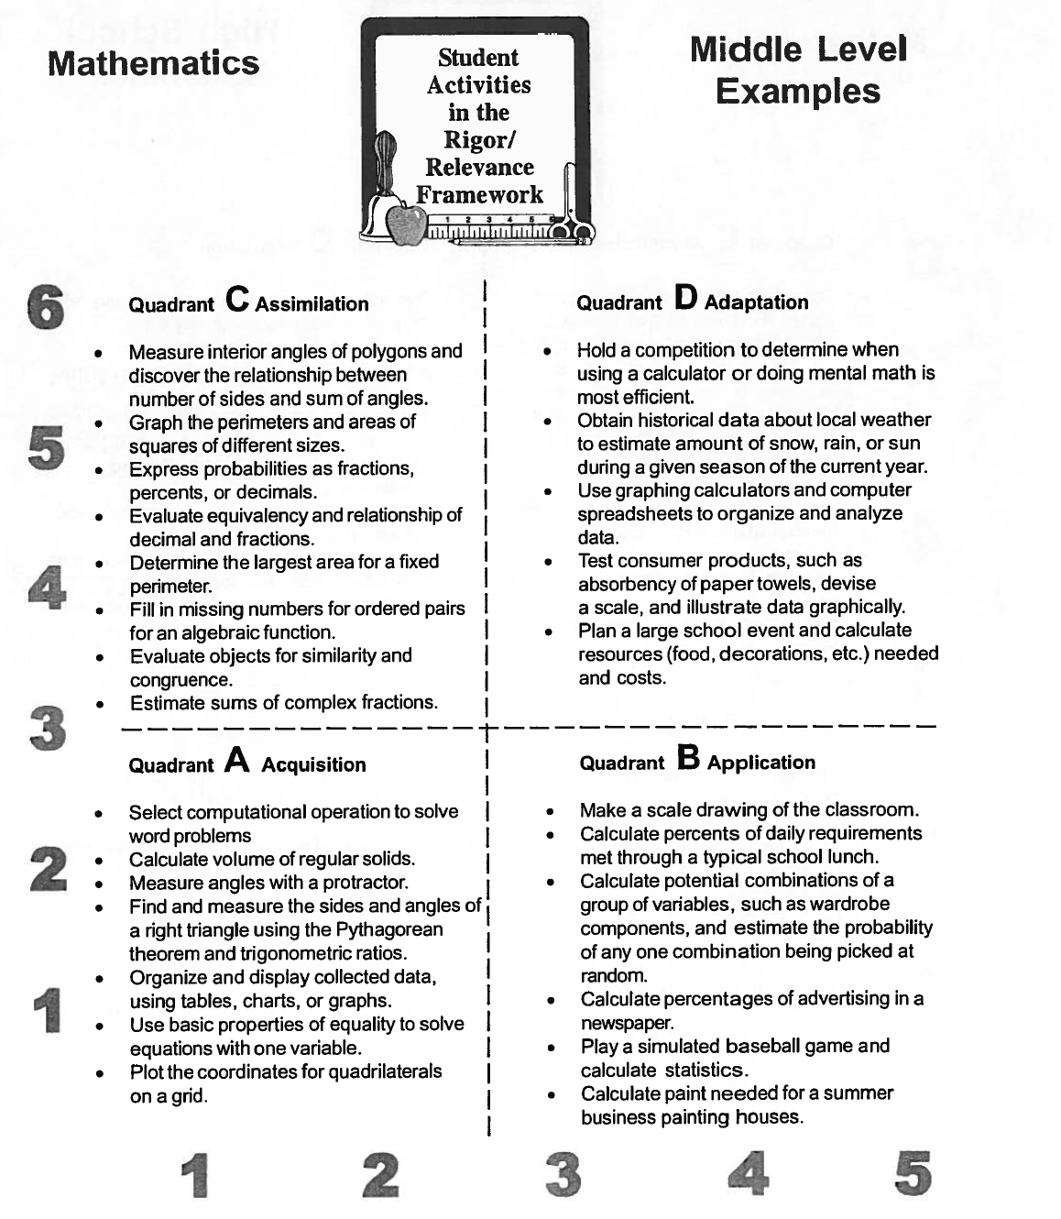
Middle Level Examples
Notes:
Part One

Slide 10
Rigor/Relevance Framework Teacher/Student Roles
C
D
Student Think
Student Think & Work
High
R I G O R
International Center for Leadership in Education (n.d.)
A
B
Low
Teacher Work
Student Work
Low
High
RELEVANCE
Notes:
Part One
TIME: 10 minutes (CONTINUED for Slides 10 to 19)
___________________________________________________________________________________
The four quadrants of the Rigor/Relevance Framework engage students and teachers in different roles.
In Quadrant A, “teachers expend energy to create and assess learning activities—providing information, creating worksheets, and grading student work. The student is often the passive learner.”¹
In Quadrant B, “the emphasis is on the student doing real-world work. This student work is often more complicated than Quadrant A work and requires more time.” ¹
In Quadrant C, “students are expected to think in complex ways—to analyze, compare, create and evaluate.”¹
In Quadrant D, learning “is more demanding and requires students to think and work. Roles shift from the teacher-centered instruction in Quadrant A to student-centered instruction in Quadrants B, C, and D.”¹
As we think about preparing our students for the 21st Century, we want to actively engage them in more rigorous and relevant instruction, spending more time in Quadrants B, C, and D.
So how do we get our students to think and engage in rigorous tasks?
¹International Center for Leadership (n.d.). Rigor/Relevance Framework.

Slide 11
Number Talks Strategy
Number Talks are a large or small group meeting where the teacher poses intentionally selected problems for students to solve. They are short, ongoing conversations where children are encouraged to add, subtract, multiply and divide in ways that are meaningful to them, rather than following procedures that are not.

Slide 12
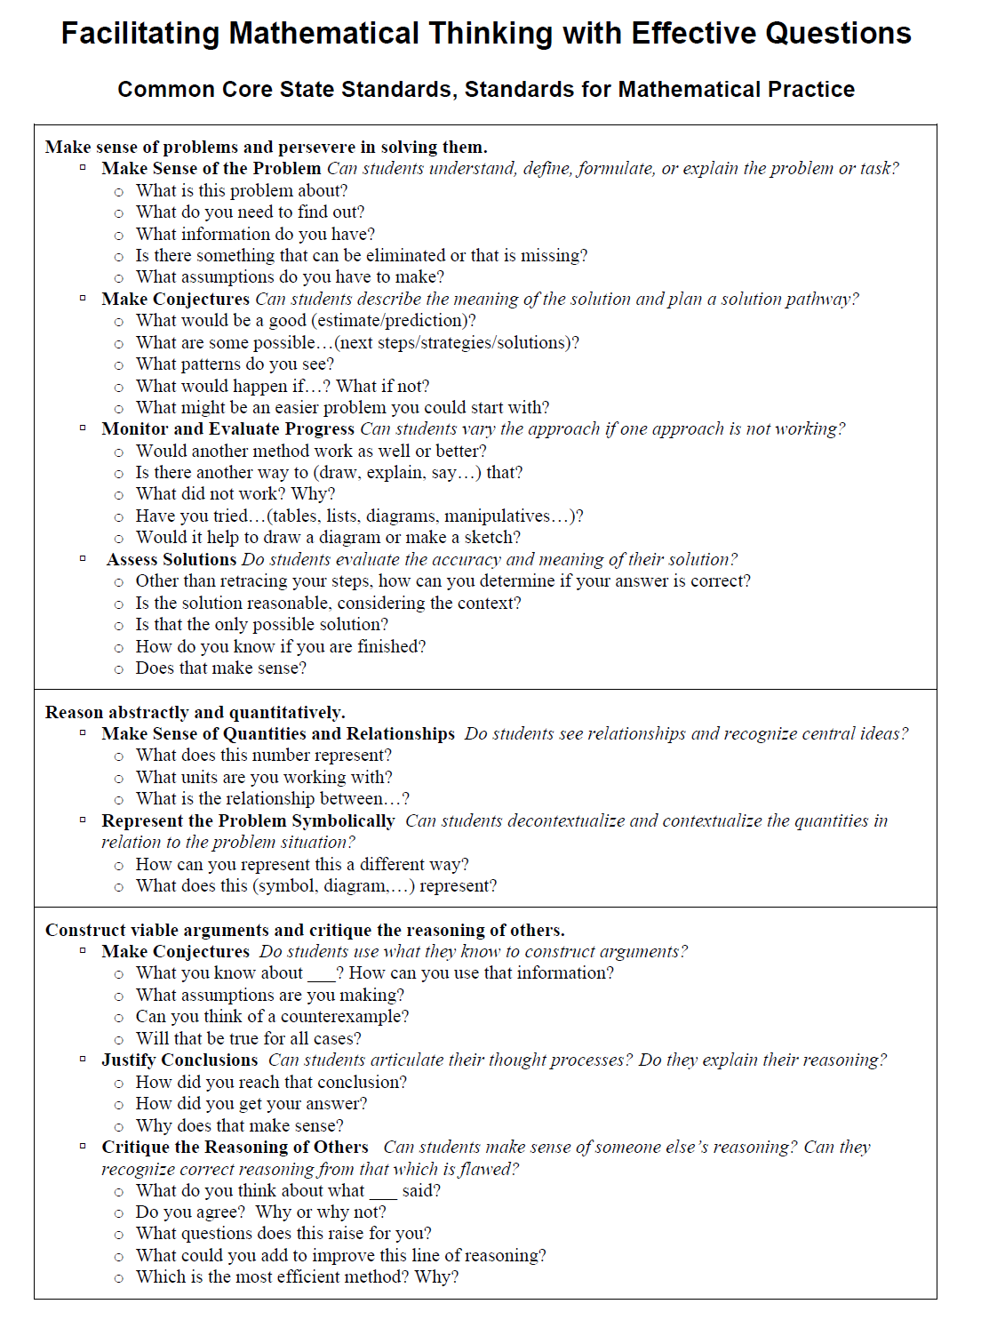
Notes:
Part Two
Page 68 of handouts

Slide 13
Standards for Mathematical Practice
2. Reason abstractly and quantitatively.
3. Construct viable arguments and critique the reasoning of others.
Overarching habits of mind of a productive mathematical thinker
4. Model with mathematics.
5. Use appropriate tools strategically.
Reasoning and explaining
1. Make sense of problems and persevere in solving them.
6. Attend to precision.
Modeling and using tools
7. Look for and make use of structure.
8. Look for and express regularity in repeated reasoning.
Seeing structure and generalizing
adapted from McCallum (2011)
Standards for Mathematical Practice
13
Notes:
Part Two
TIME: 10 minutes (CONTINUED for Slides 20 to 22)
INTENT: To provide some background on the CCSS for Mathematics
___________________________________________________________________________________
William McCallum, one of the writers of the CCSS for Mathematics, has paired the Standards for Mathematical Practice in the following way.
Review the slide.
When we look at the Standards for Mathematical Practice, we can see how these standards support the kinds of thinking and work described in Quadrants B, C, and D.
This organization of the standards helps us consider the implications the CCSS will have on instruction. In addition to teaching content, we need to plan instruction to help students make sense of problems and persevere in solving them—a challenge we’ve always been faced with in mathematics, but now it is a standard we need to help students achieve.
In our lesson plans, we need to create opportunities for students to engage in reasoning and explaining or using multiple representations and tools to model problems.

Slide 14
Create a Frayer Model Poster
Essential Characteristics | Teaching Methods
Examples of What Students Will Be Doing | Non-examples of What Students Will Be Doing
Standard for Mathematical Practice
Work with a table group on one of the Standards for Mathematical Practice.
Create a Frayer Model Poster connecting student actions and teacher actions.
Notes:
TIME: 35 minutes (for Slides 23 to 24)
INTENT: To look deeply at one of the Standards for Mathematical Practice and to preview the other seven
___________________________________________________________________________________
The Frayer Model is a word categorization activity that helps learners develop their understanding of concepts. There are many variations of the Frayer Model, but most include the Essential Characteristics of the concept as well as Examples and Non-Examples of the concept. The use of examples and non-examples is a concept attainment strategy.
Essential Characteristics: The major characteristics or elements of the Standards for Mathematical Practice
Teaching Methods: Think about the CSTPs discussed earlier and the primary methods you currently use to facilitate demonstration of the Standards for Mathematical Practice.
Examples of Student Actions: What would it look like if students were engaged in this Standards for Mathematical Practice? Think about the kinds of thinking and work in the four quadrants of the Rigor/Relevance Framework.
Non-examples of what students will be doing: What would it look like if students were not engaged in Standards for Mathematical Practice? What would they be doing instead?
[click] Review the activity instructions.
Assign a practice to each table. Refer them to p. 47 of the CCSS for Mathematics handout. Remind the group assigned to SMP 4, Modeling with Mathematics, to refer to pp. 60-61. Encourage them to include the basic modeling cycle on their poster.
HANDOUTS:
CCSS for Mathematics
SUPPLIES:
Chart paper
Markers

Slide 15
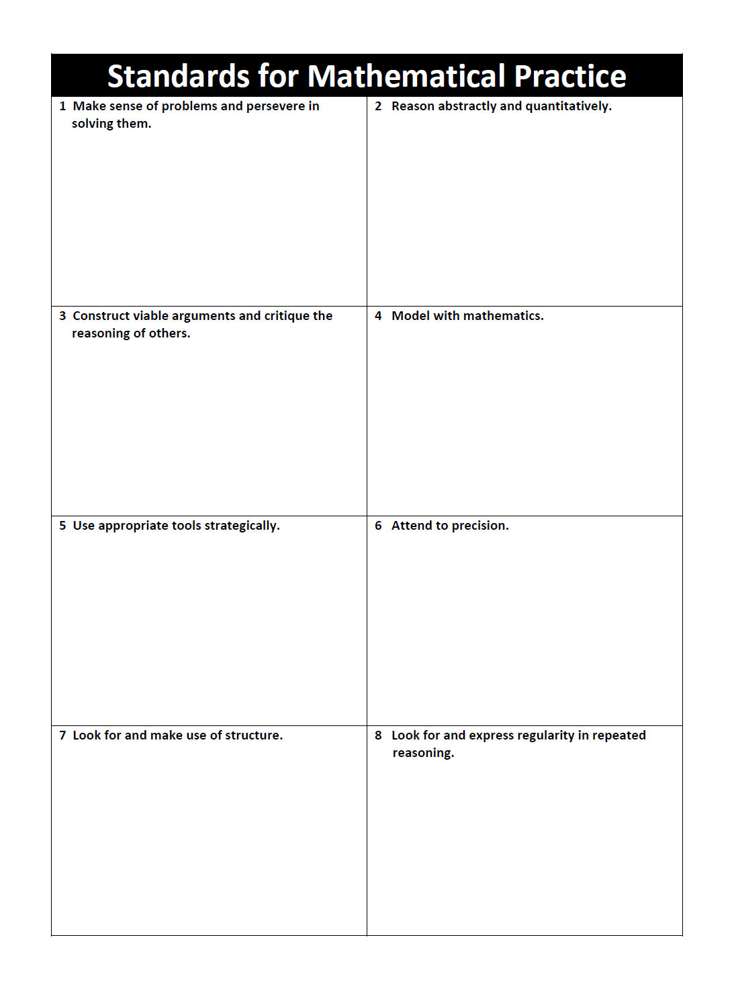
Notes:
Part Two Pg 66 Resources pg 65 is abbreviated Mathematical Practices. Use this with a gallery walk.

